Slide 1
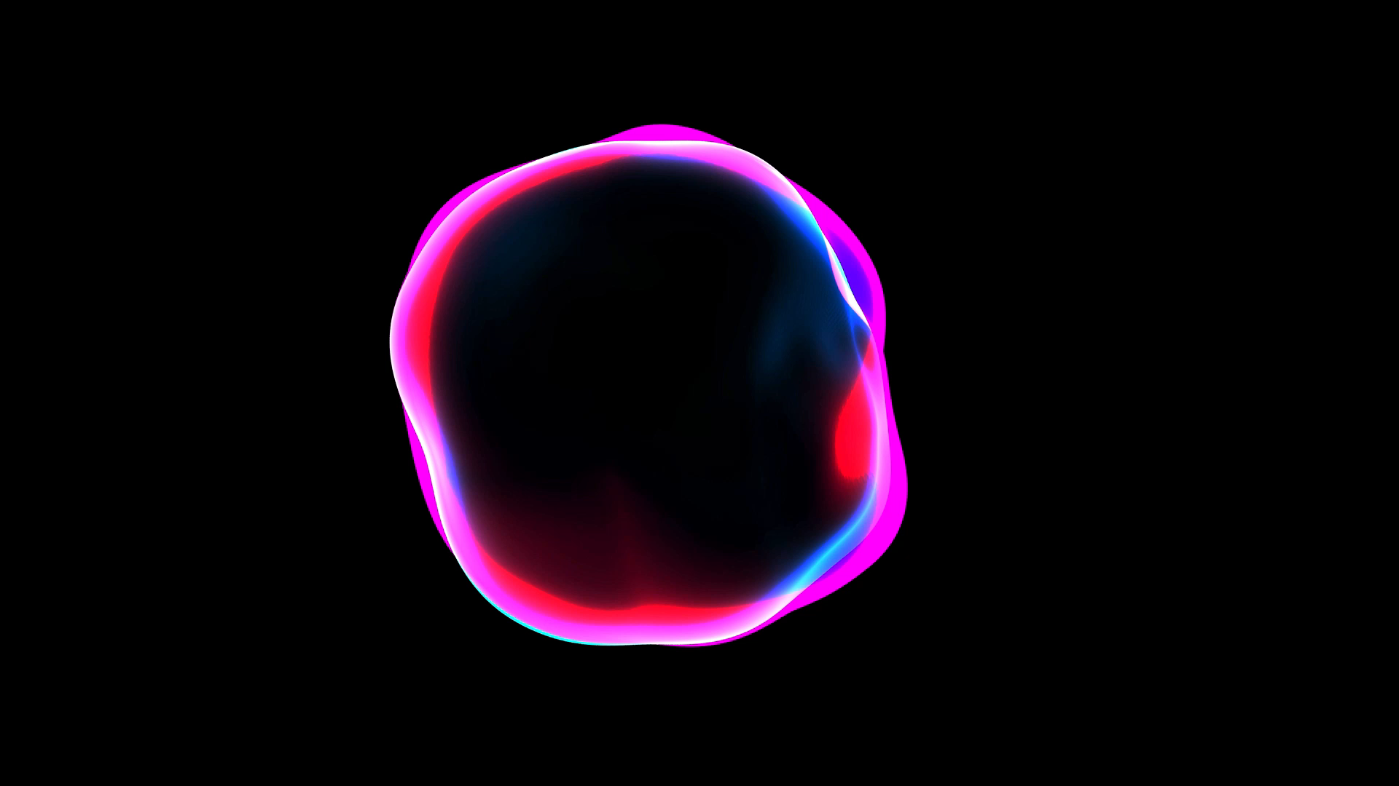
Stable Diffusion
Binxu Wang, John Vastola
Machine Learning from Scratch
Nov.1st 2022

Slide 2
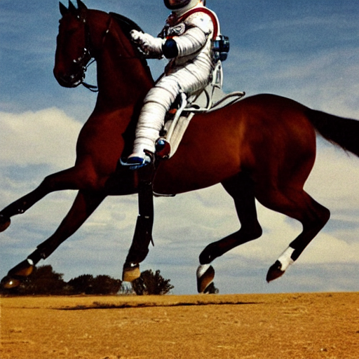
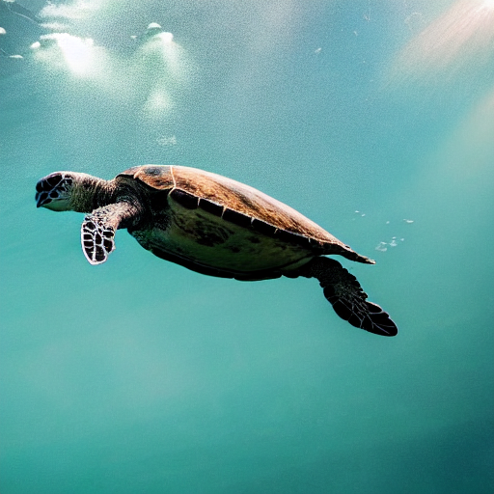
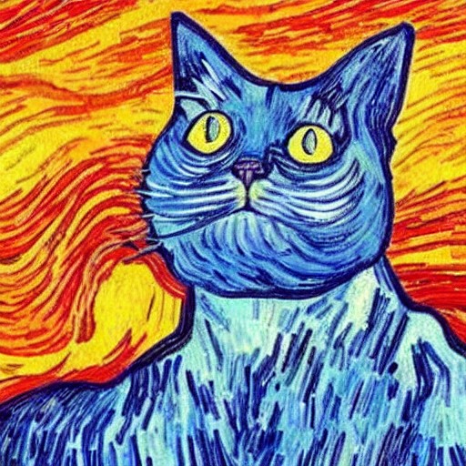
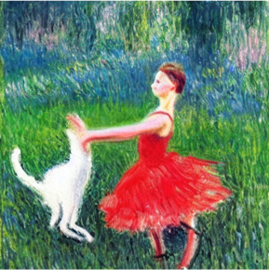
What’s the deal with all these pictures?

Slide 3
These pictures were generated by Stable Diffusion,
a recent diffusion generative model.
It can turn text prompts (e.g. “an astronaut riding a horse”) into images.
It can also do a variety of other things!
You may have also heard of DALL·E 2, which works in a similar way.

Slide 4
Why should we care?
Could be a model of imagination.
Similar techniques could be used to generate
any number of things (e.g. neural data).
"a lovely cat running in the desert in Van Gogh style, trending art."
It’s cool!

Slide 5
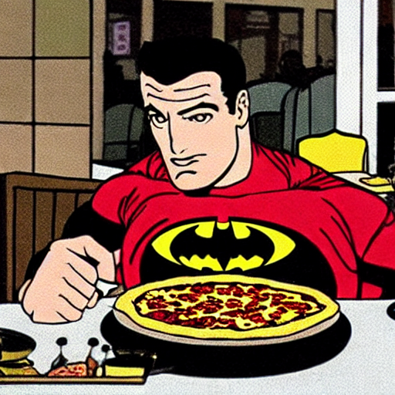
How does it work?
It’s complicated…
but here’s the high-level idea.
“Batman eating pizza in a diner"

Slide 6
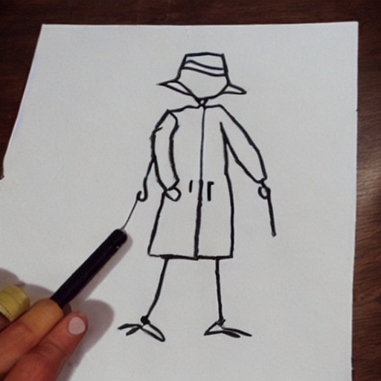
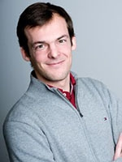
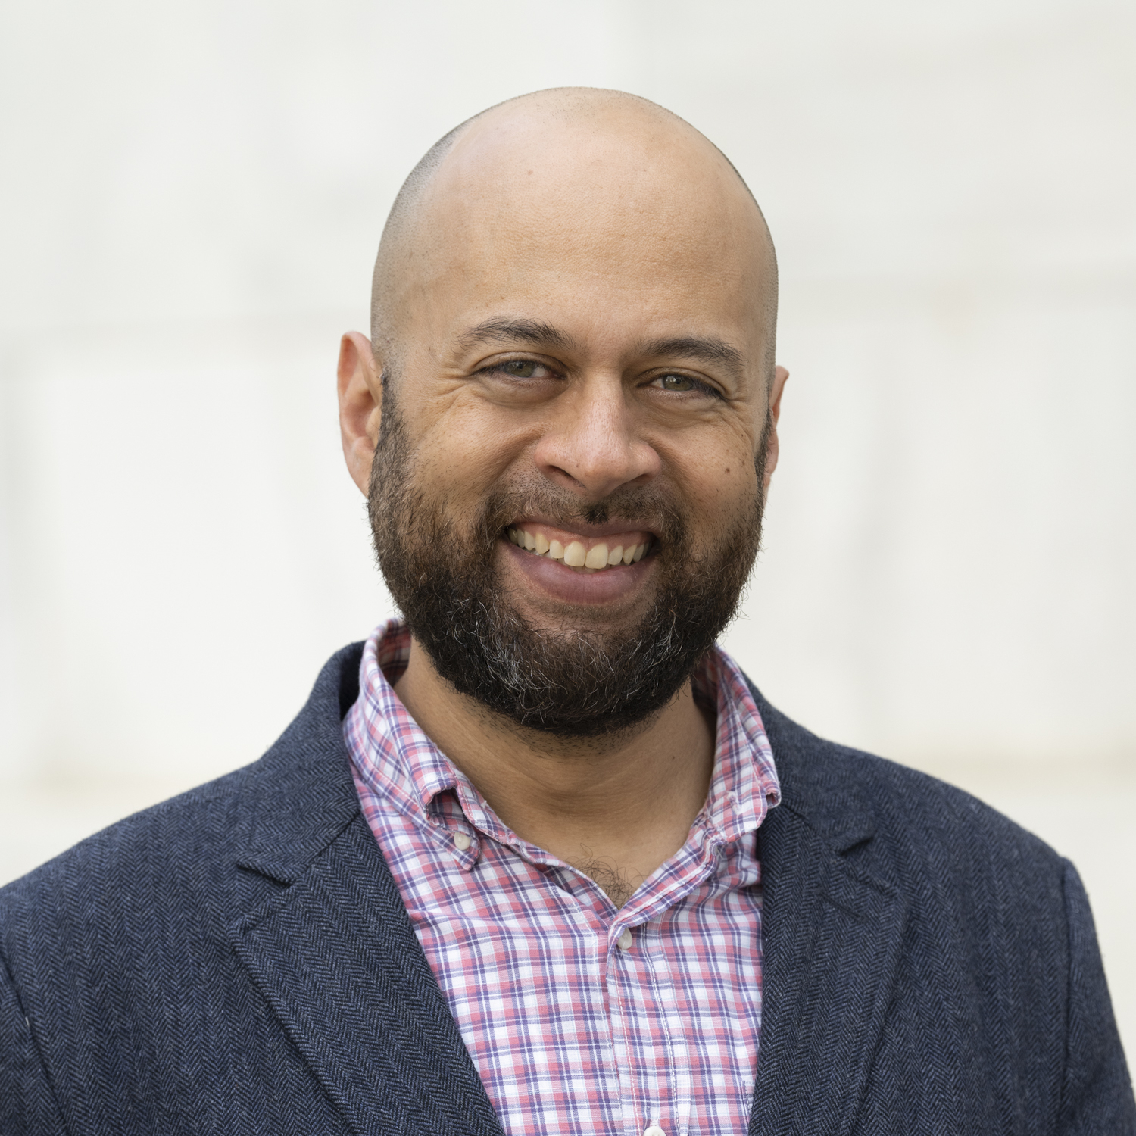
What do we need?
“bad stick figure drawing"
Example pictures of people
1. Method of learning to generate new stuff given many examples

Slide 7
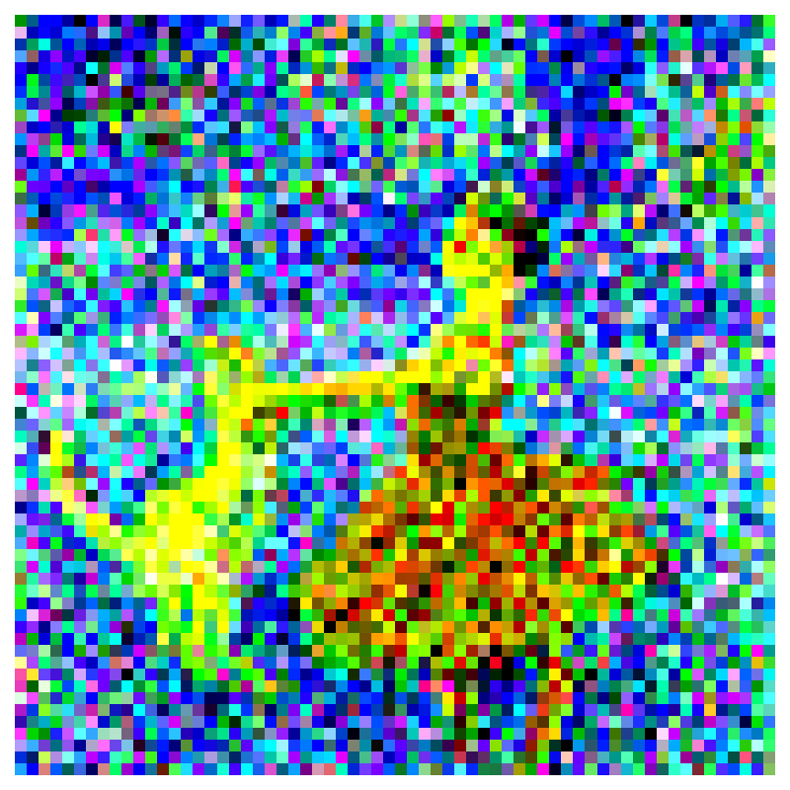
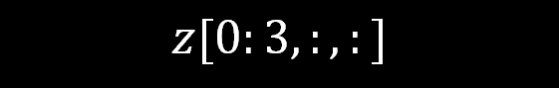
What do we need?
2. Way to link text and images
“cool professor person”
3. Way to compress images
(for speed in training and generation)
$$z[0:3,:,:]$$

Slide 8
What do we need?
4. Way to add in good image-related inductive biases…
…since when you’re generating something new, you need a way to safely go beyond the images you’ve seen before.

Slide 9
What do we need?
1. Method of learning to generate new stuff
Forward/reverse dffusion
2. Way to link text and images
Text-image representation model
3. Way to compress images
Autoencoder
U-net
architecture
4. Way to add in good inductive biases
+ ‘attention’
Making a ‘good’ generative model is about making all these parts work together well!

Slide 10
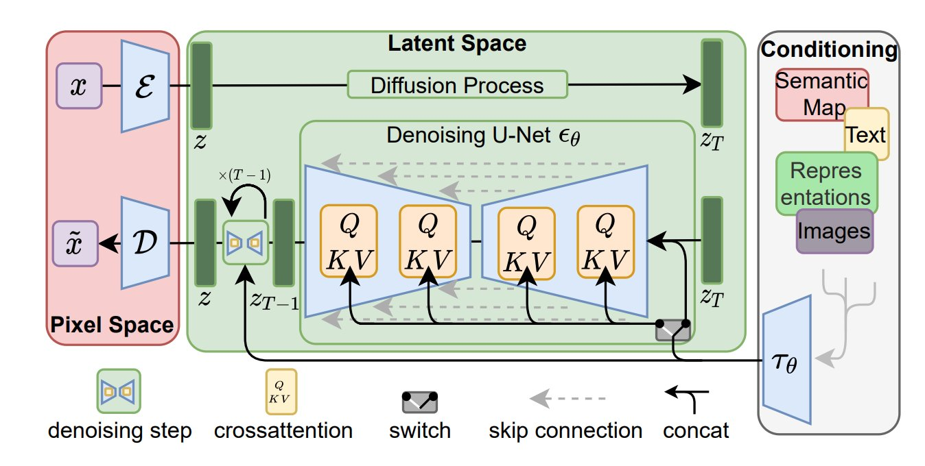

Slide 11
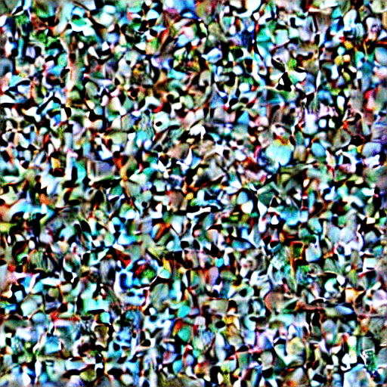
Stable Diffusion in Action

Slide 12
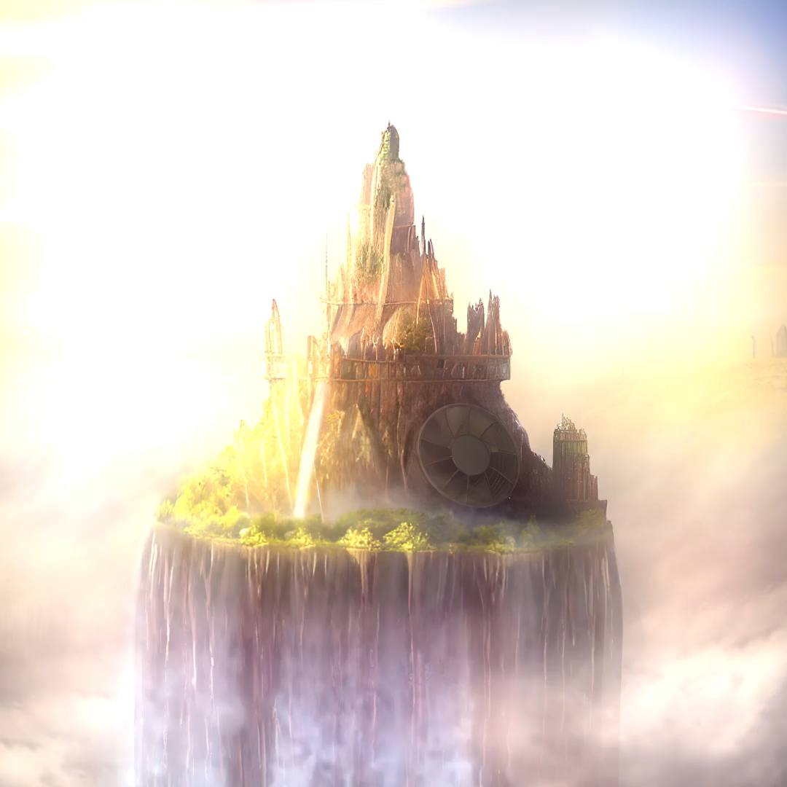
Cartoon with StableDiffusion + Cartoon
https://www.reddit.com/r/StableDiffusion/comments/xcjj7u/sd_img2img_after_effects_i_generated_2_images_and/

Slide 13
Some Resources
Diffusion model in general
What are Diffusion Models? | Lil'Log
Generative Modeling by Estimating Gradients of the Data Distribution | Yang Song
Stable diffusion
Annotated & simplified code: U-Net for Stable Diffusion (labml.ai)
Illustrations: The Illustrated Stable Diffusion – Jay Alammar
Attention & Transformers
The Illustrated Transformer

Slide 14
Outline
Stable Diffusion is cool!
Build Stable Diffusion “from Scratch”
Principle of Diffusion models (sampling, learning)
Diffusion for Images – UNet architecture
Understanding prompts – Word as vectors, CLIP
Let words modulate diffusion – Conditional Diffusion, Cross Attention
Diffusion in latent space – AutoEncoderKL
Training on Massive Dataset. – LAION 5Billion
Let’s try ourselves.
Notes:
Adding representative tokens to help.

Slide 15
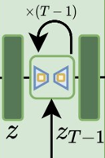
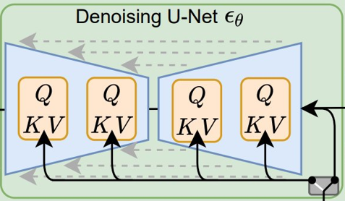
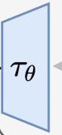
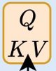
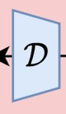
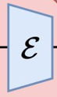
Outline
Stable Diffusion is cool!
Build Stable Diffusion “from Scratch”
Principle of Diffusion models (sampling, learning)
Diffusion for Images – UNet architecture
Understanding prompts – Word as vectors, CLIP
Let words modulate diffusion – Conditional Diffusion, Cross Attention
Diffusion in latent space – AutoEncoderKL
Training on Massive Dataset. – LAION 5Billion
Let’s try ourselves.
Notes:
Adding representative tokens to help.

Slide 16
Principle of Diffusion Models
Learning to generate by iterative denoising.

Slide 17
“Creating noise from data is easy; Creating data from noise is generative modeling.”
-- Song, Yang
Notes:
“To turn data into noise, it’s called diffusion; To turn noise into data, it’s called generative modelling.”

Slide 18
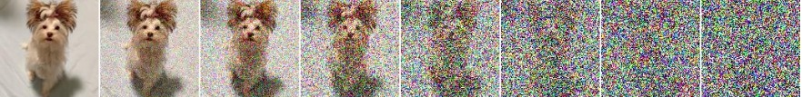
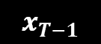
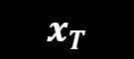
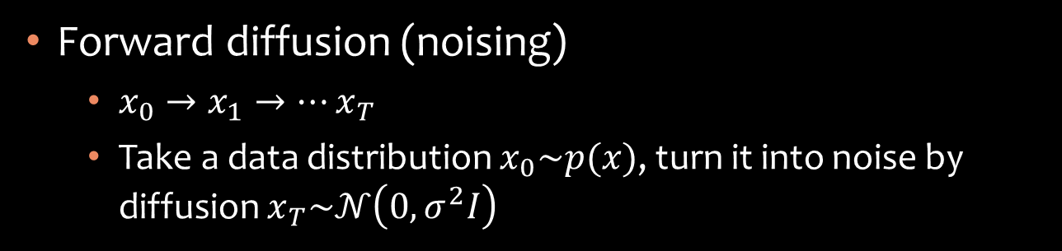
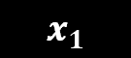
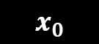
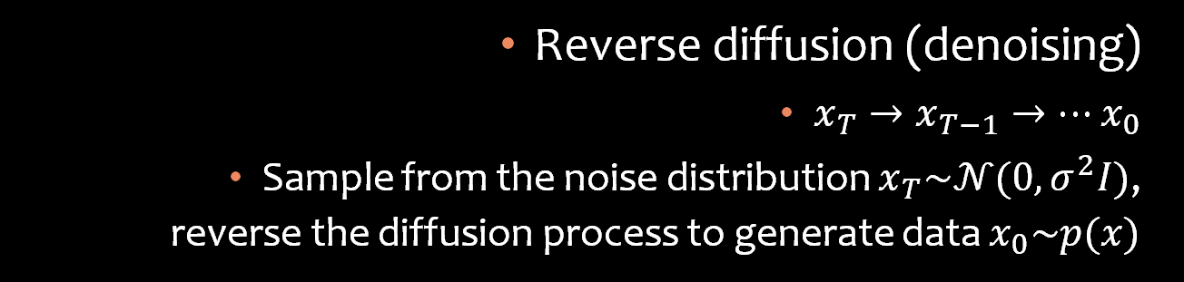
Diffusion models
Forward diffusion (noising)
$x_{0}→x_{1}→…x_{T}$
Take a data distribution $x_{0}\sim p(x)$, turn it into noise by diffusion $x_{T}\sim 𝒩\left(0,σ^{2}I\right)$
$$x_{0}$$
$$x_{1}$$
$$x_{T−1}$$
$$x_{T}$$
Reverse diffusion (denoising)
$x_{T}→x_{T−1}→…x_{0}$
Sample from the noise distribution $x_{T}\sim 𝒩(0,σ^{2}I)$, reverse the diffusion process to generate data $x_{0}\sim p(x)$

Slide 19
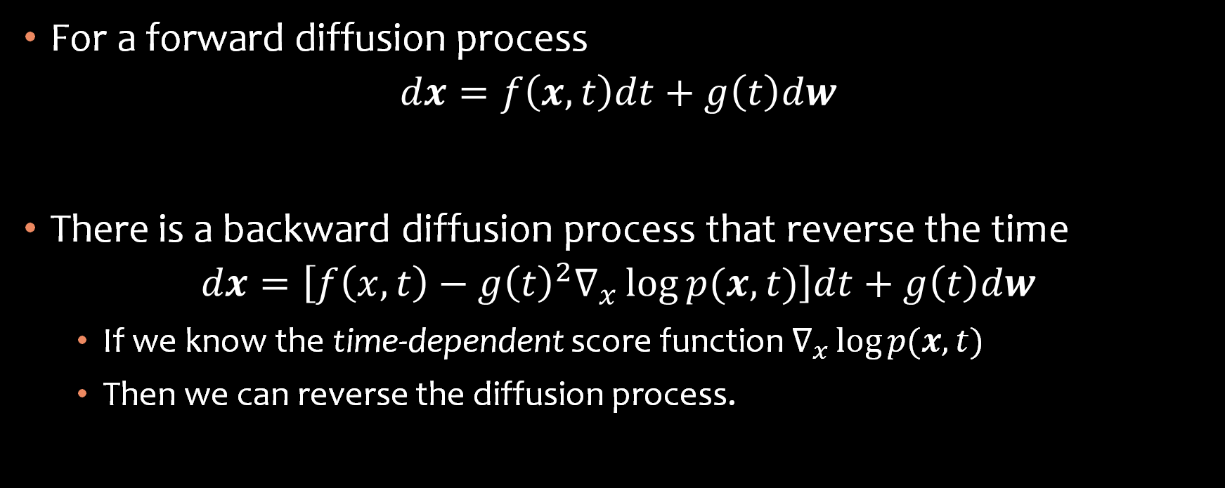
Math Formalism
For a forward diffusion process
$$dx=f\left(x,t\right)dt+g\left(t\right)dw$$
There is a backward diffusion process that reverse the time
$$dx=\left[f\left(x,t\right)−g{\left(t\right)}^{2}∇_{x}\log{p(x,t)}\right]dt+g\left(t\right)dw$$
If we know the time-dependent score function $∇_{x}\log{p(x,t)}$
Then we can reverse the diffusion process.

Slide 20
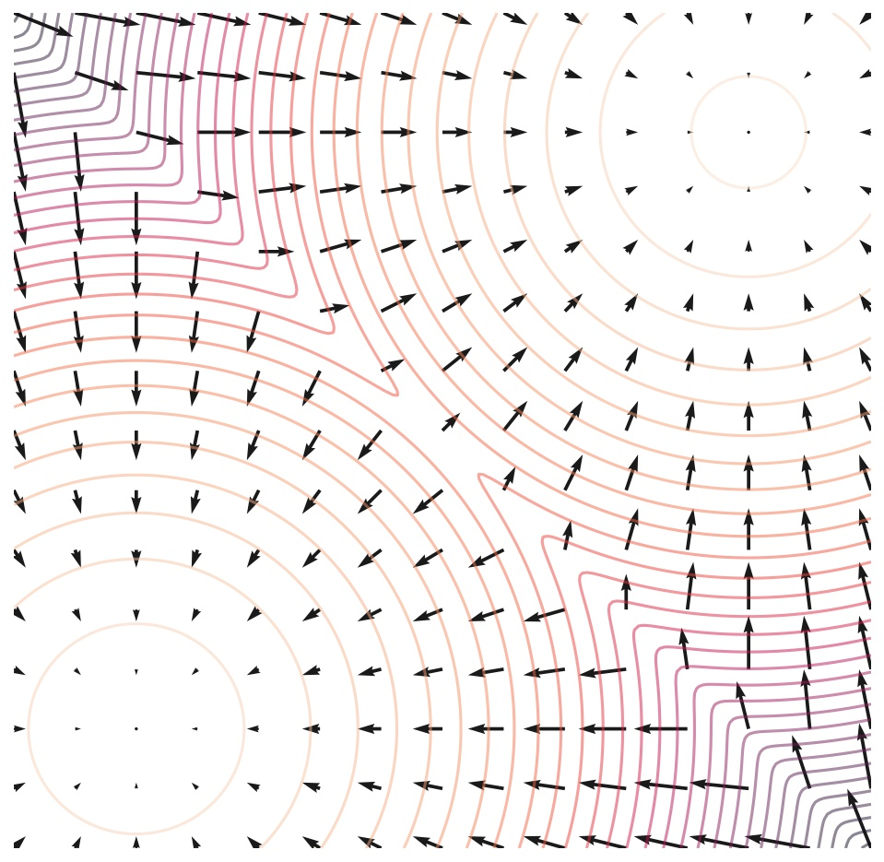
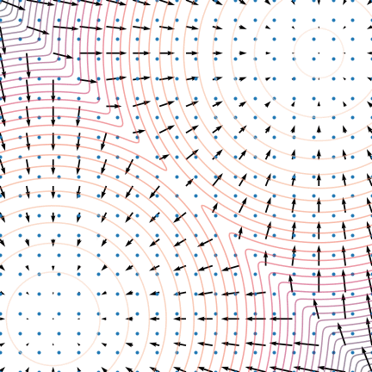
Animation for the Reverse Diffusion
Score Vector Field
Reverse Diffusion guided by the score vector field
https://yang-song.net/blog/2021/score/

Slide 21
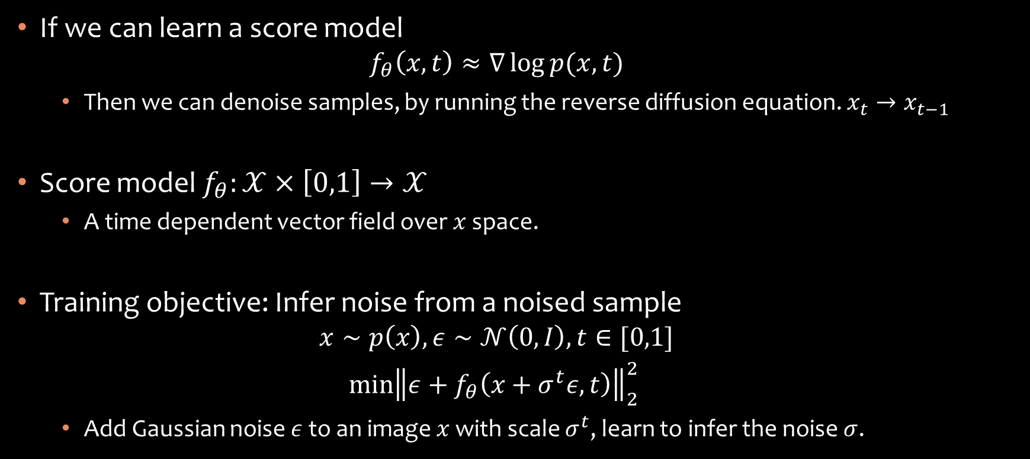
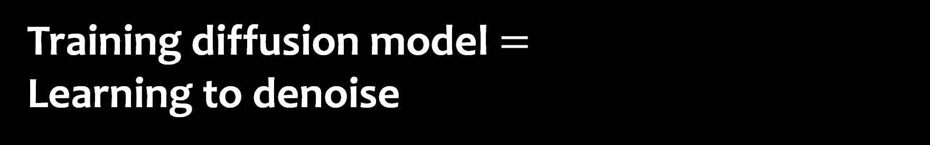
Training diffusion model $=$ Learning to denoise
If we can learn a score model
$$f_{θ}\left(x,t\right)≈∇\log{p(x,t)}$$
Then we can denoise samples, by running the reverse diffusion equation. $x_{t}→x_{t−1}$
Score model $f_{θ}:𝒳×\left[0,1\right]→𝒳$
A time dependent vector field over $x$ space.
Training objective: Infer noise from a noised sample
$$x∼p\left(x\right), ε∼𝒩\left(0,I\right),t∈[0,1]$$
$$\min{{\left\|ε+f_{θ}\left(x+σ^{t}ε,t\right)\right\|}_{2}^{2} }$$
Add Gaussian noise $ε$ to an image $x$ with scale $σ^{t}$, learn to infer the noise $σ$.

Slide 22
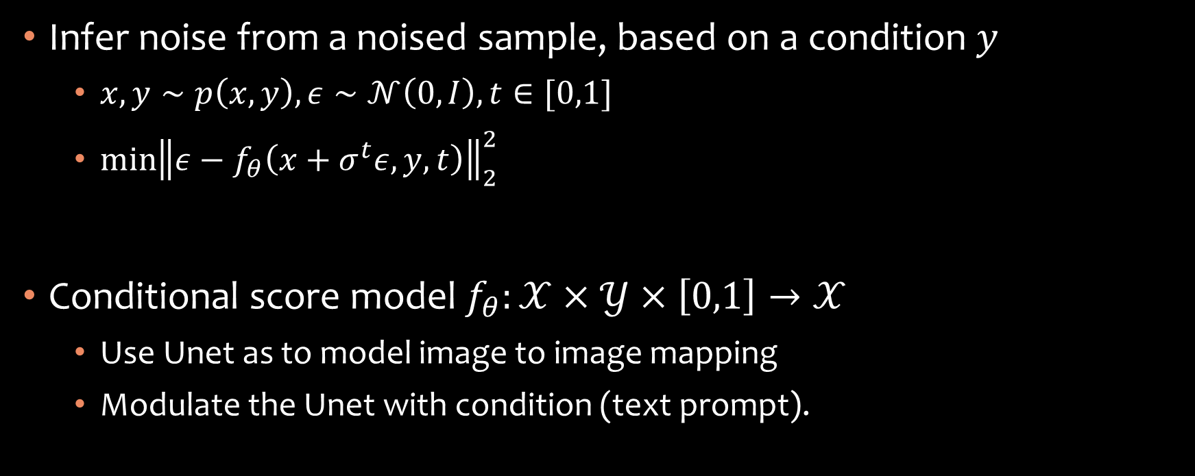
Conditional denoising
Infer noise from a noised sample, based on a condition $y$
$x,y∼p\left(x,y\right), ε∼𝒩\left(0,I\right),t∈[0,1]$
$\min{{\left\|ε−f_{θ}\left(x+σ^{t}ε,y,t\right)\right\|}_{2}^{2} }$
Conditional score model $f_{θ}:𝒳×𝒴×\left[0,1\right]→𝒳$
Use Unet as to model image to image mapping
Modulate the Unet with condition (text prompt).
Notes:
X, y
X, y
More examples

Slide 23

Comparing Generative Models
https://lilianweng.github.io/posts/2021-07-11-diffusion-models/

Slide 24
Diffusion vs GAN / VAE
GAN
Diffusion
One shot generation. Fast.
Harder to control in one pass.
Adversarial min-max objective. Can collapse.
Multi-iteration generation. Slow.
Easier to control during generation.
Simple objective, no adversary in training.

Slide 25
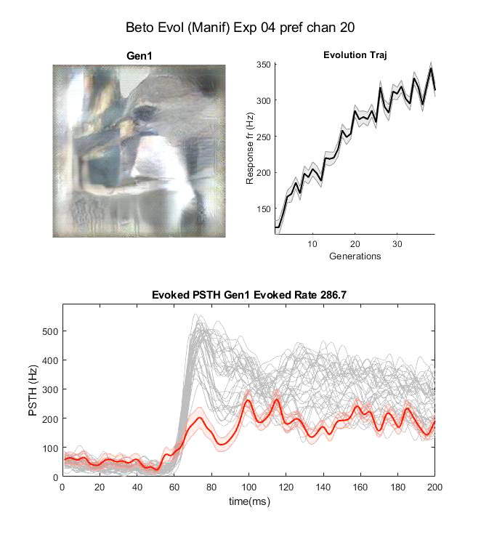
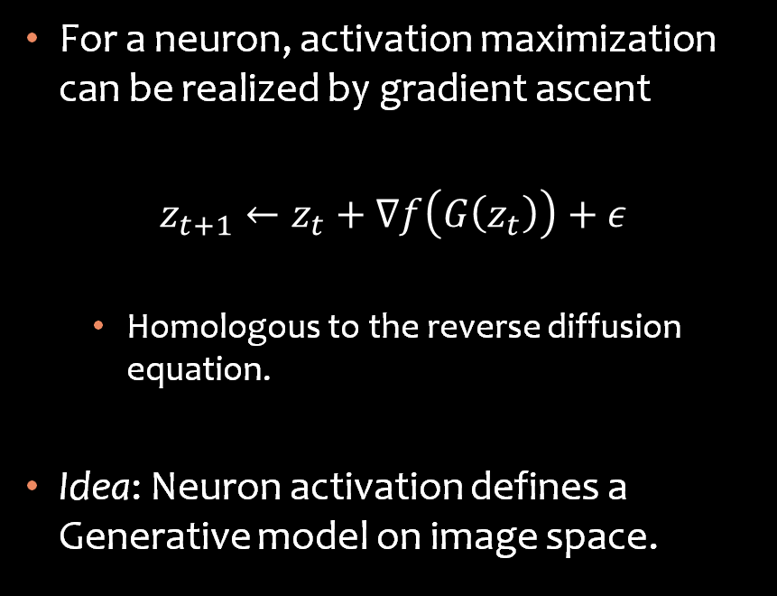
Activation maximization ~ Reverse Diffusion
For a neuron, activation maximization can be realized by gradient ascent
$$z_{t+1}←z_{t}+∇f\left(G\left(z_{t}\right)\right)+ε$$
Homologous to the reverse diffusion equation.
Idea: Neuron activation defines a Generative model on image space.

Slide 26
Modelling Score function over Image Domain
Introducing UNet

Slide 27

Convolutional Neural Network
Features of larger scale (larger RF)
Higher abstraction level.
CNN parametrizes function over images
Motivation
Features are translational invariant
Extract feature at different scale / abstraction level
Key modules
Convolution
Downsamping (Max-pool)
VGG

Slide 28
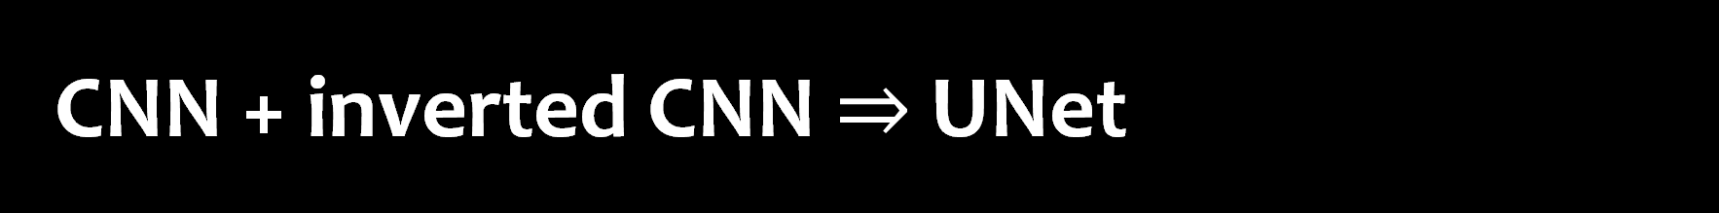
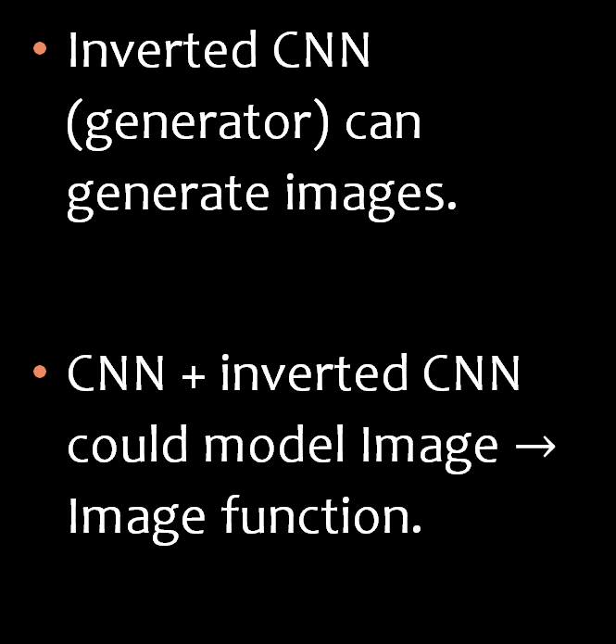
CNN + inverted CNN $⇒$ UNet
Inverted CNN (generator) can generate images.
CNN + inverted CNN could model Image $→$ Image function.
Down Sampling
Up Sampling
Convolution
TransposedConvolution

Slide 29
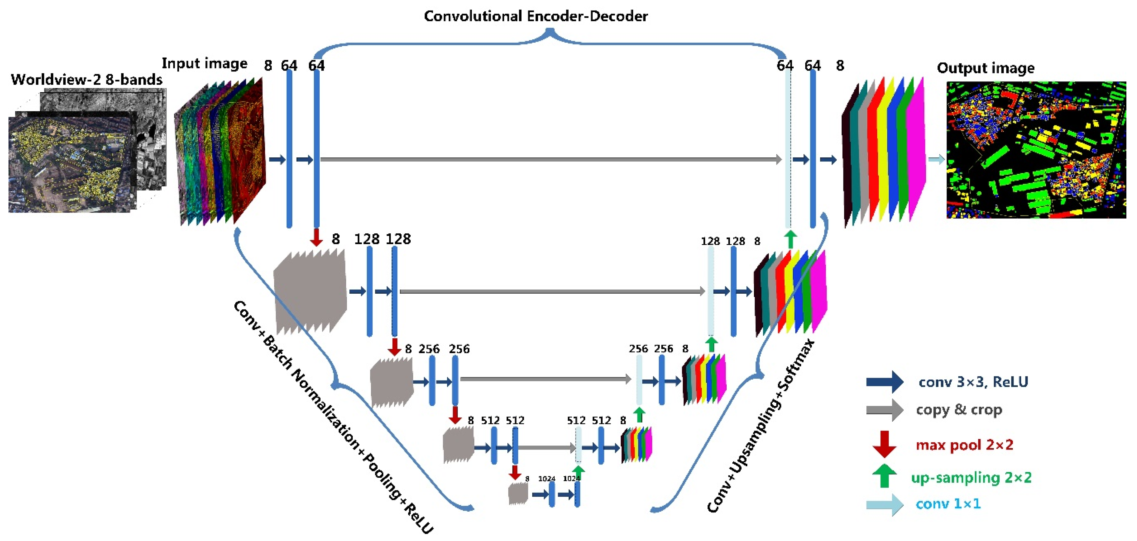
UNet: a natural architecture for image-to-image function
Skip connection
Transporting information at the same resolution.
Down (sampling) side
Encoder
Up (sampling) side
Decoder

Slide 30
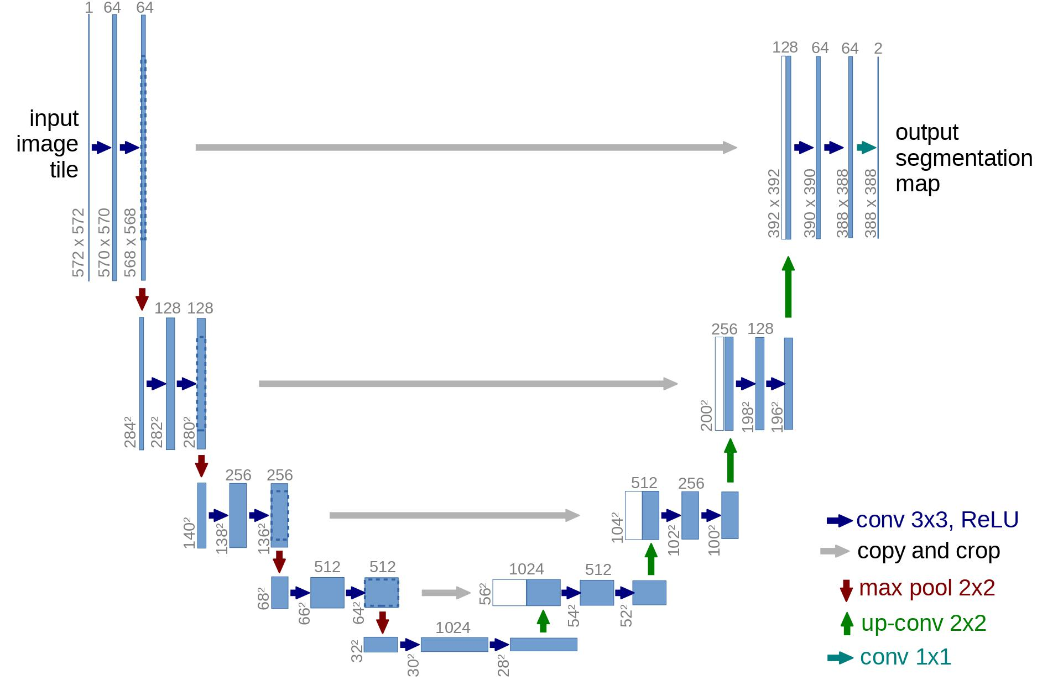
Key Ingredients of UNet
Convolution operation
Save parameter, spatial invariant
Down/Up sampling
Multiscale / Hierarchy
Learn modulation at multi scale and multi-abstraction levels.
Skip connection
No bottleneck
Route feature of the same scaledirectly.
Cf. AutoEncoder has bottleneck
Notes:
AutoEncoder has bottleneck because it want the latent representation to retain the most information.
Here we don’t care about the middle part, we only care about input outputs.

Slide 31

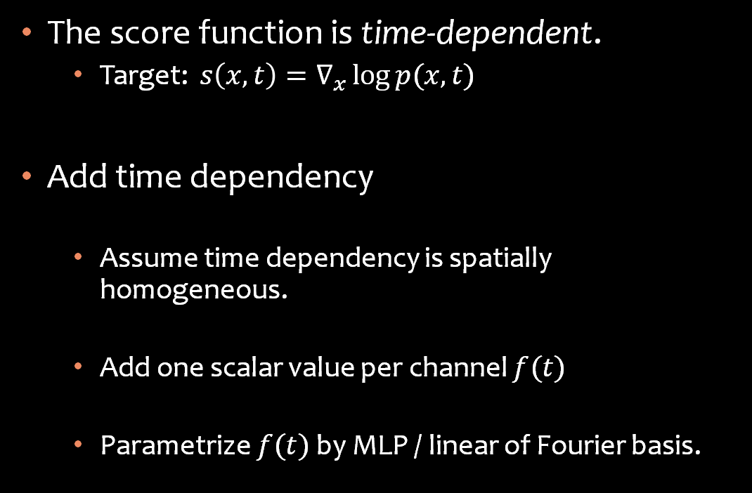
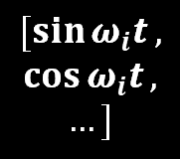
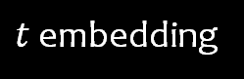
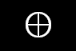
Note: Add Time Dependency
The score function is time-dependent.
Target: $s\left(x,t\right)=∇_{x}\log{p(x,t)}$
Add time dependency
Assume time dependency is spatially homogeneous.
Add one scalar value per channel $f(t)$
Parametrize $f(t)$ by MLP / linear of Fourier basis.
Conv
tensor
$t$ embedding
Linear/MLP
$$⊕$$
$$t$$
$$[\sin{ω_{i}t},$$
$$\cos{ω_{i}t},$$
$$…]$$

Slide 32
Unet in Stable Diffusion
(conv_in): Conv2d(4, 320, kernel_size=(3, 3), stride=(1, 1), padding=(1, 1))
(time_proj): Timesteps()
(time_embedding): TimestepEmbedding
(linear_1): Linear(in_features=320, out_features=1280, bias=True)
(act): SiLU()
(linear_2): Linear(in_features=1280, out_features=1280, bias=True)
(down_blocks):
(0): CrossAttnDownBlock2D
(1): CrossAttnDownBlock2D
(2): CrossAttnDownBlock2D
(3): DownBlock2D
(up_blocks):
(0): UpBlock2D
(1): CrossAttnUpBlock2D
(2): CrossAttnUpBlock2D
(3): CrossAttnUpBlock2D
(mid_block): UNetMidBlock2DCrossAttn
(attentions):
(resnets):
(conv_norm_out): GroupNorm(32, 320, eps=1e-05, affine=True)
(conv_act): SiLU()
(conv_out): Conv2d(320, 4, kernel_size=(3, 3), stride=(1, 1), padding=(1, 1))

Slide 33
Tips: Tricky part in your implementation
Making the spatial dimension & channel match in downward and upward convolution.
Write your special forward function. Save hidden states during down sampling, Pop in up sampling.

Slide 34
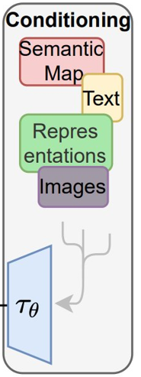
How to understand prompts?
Language / Multimodal Transformer, CLIP!

Slide 35
Word as Vectors: Language Model 101
Unlike pixel, meaning of word are not explicitly in the characters.
Word can be represented as index in dictionary
But index is also meaning less.
Represent words in a vector space
Vector geometry => semantic relation.
Words in a sentence
I love cats and dogs .
Token Index
328, 793, 3989, 537, 3255, 269
Word Vectors
Notes:
pipe.tokenizer("I love cats and dogs.")

Slide 36
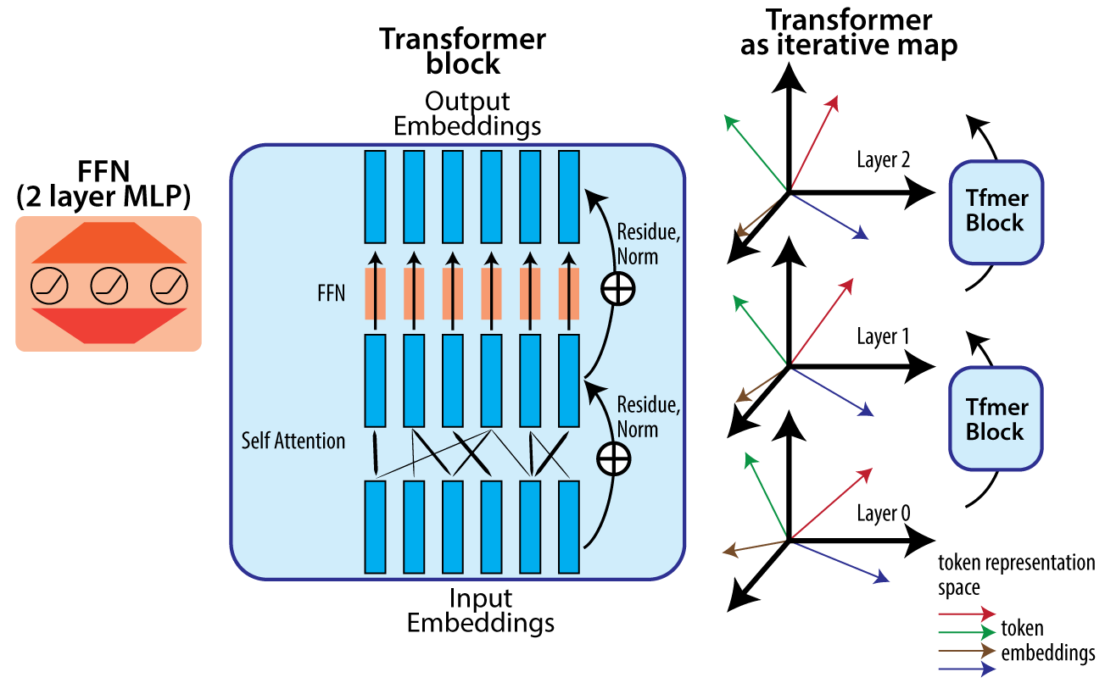
Word Vector in Context: RNN / Transformers
N layers ……
Meaning of word depends on context, not always the same.
“I book a ticket to buy that book.”
Word vectors should depend on context.
Transformers let each word “absorb” influence from other words to be “contextualized”
Transformer
Block
Transformer
Block
More on attention later…
I love cats and dogs .

Slide 37
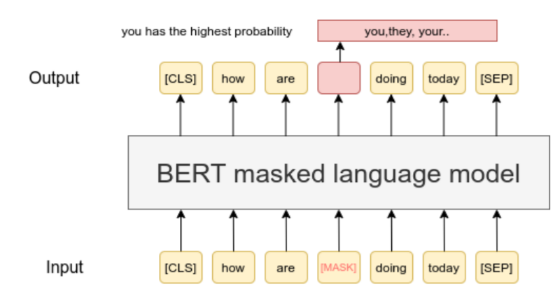
Learning Word Vectors: GPT & BERT & CLIP
Downstream Classifier can decode:
Part of speech, Sentiment, …
Self-supervised learning of word representation
Predicting missing / next words in a sentence. (BERT, GPT)
Contrastive Learning, matching image and text. (CLIP)
MLM — Sentence-Transformers documentation (sbert.net)

Slide 38
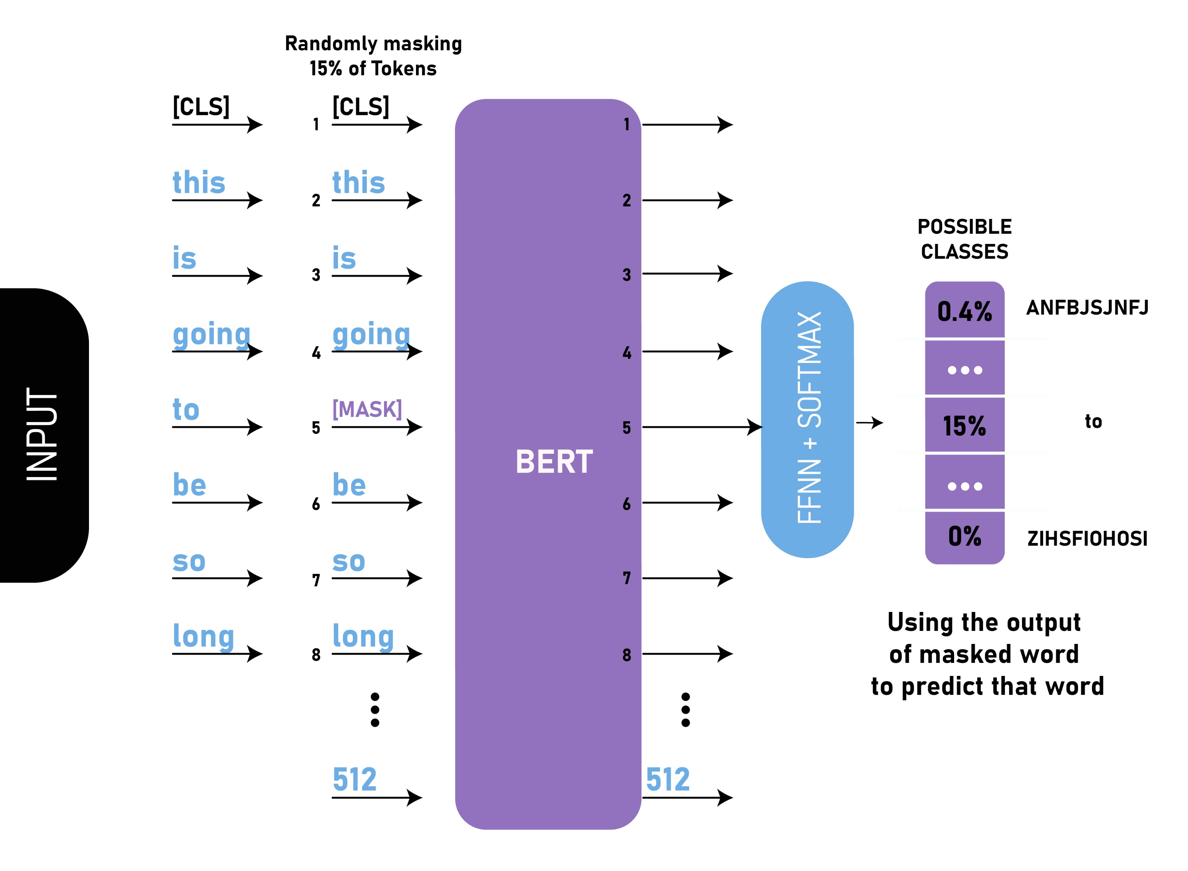

Slide 39
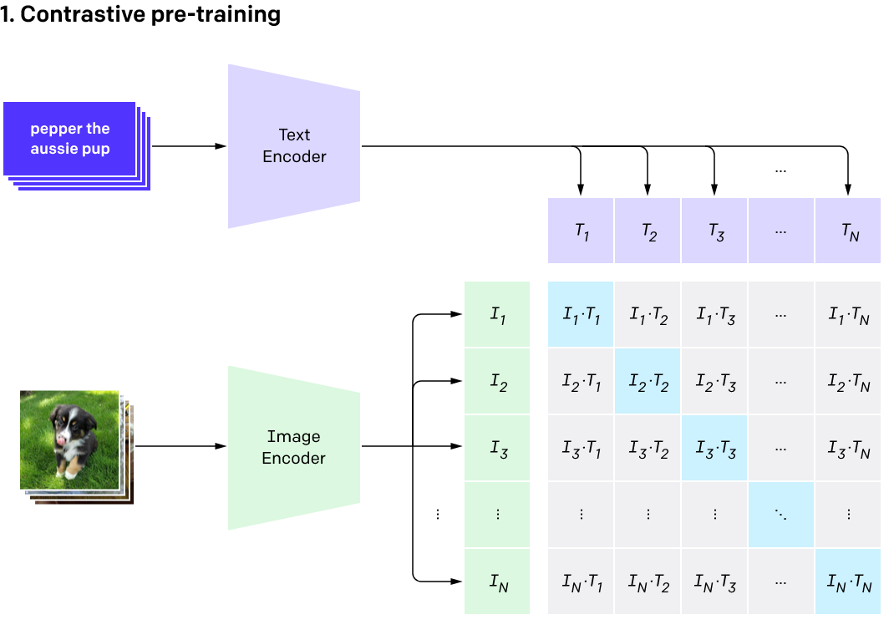
Joint Representation for Vision and Language : CLIP
Transformer
Learn a joint encoding space for text caption and image
Maximize representation similarity between an image and its caption.
Minimize other pairs
Vision Transformer
CLIP paper 2021

Slide 40
Text Sequence Encoding : CLIP
Version: CLIP ViT-L/14 text encoder

Slide 41
Choice of text encoding
Encoder in Stable Diffusion: pre-trained CLIP ViT-L/14 text encoder
Word vector can be randomly initialized and learned online.
Representing other conditional signals
Object categories (e.g. Shark, Trout, etc.):
1 vector per class
Face attributes (e.g. {female, blonde hair, with glasses, …}, {male, short hair, dark skin}):
set of vectors, 1 vector per attributes
Time to be creative!!

Slide 42
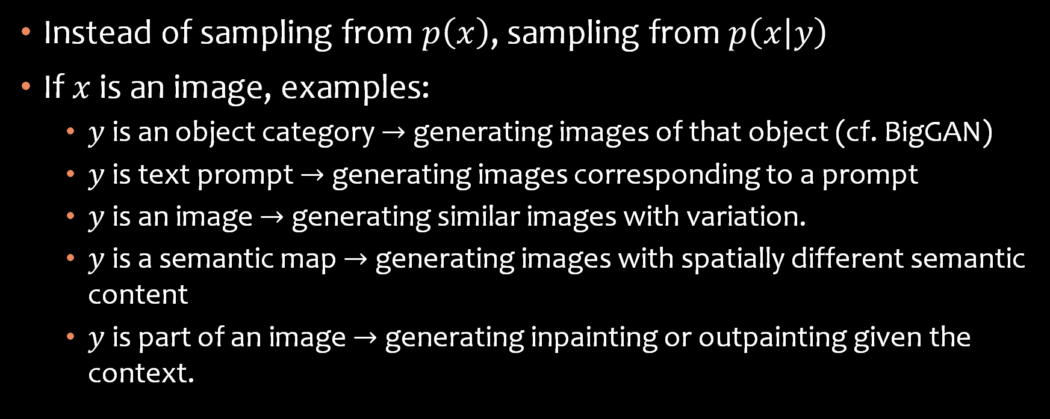
Conditional Diffusion Models
Instead of sampling from $p\left(x\right)$, sampling from $p\left(x | y\right)$
If $x$ is an image, examples:
$y$ is an object category $→$ generating images of that object (cf. BigGAN)
$y$ is text prompt $→$ generating images corresponding to a prompt
$y$ is an image $→$ generating similar images with variation.
$y$ is a semantic map $→$ generating images with spatially different semantic content
$y$ is part of an image $→$ generating inpainting or outpainting given the context.

Slide 43
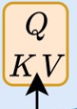
How does text affect diffusion?
Incoming Cross Attention

Slide 44









Origin of Attention: Machine Translation (Seq2Seq)
Original sentence
French Translation
I love cats and dogs .
J'adore
les
chats
et les chiens.
Encoder hidden state
(Word Vectors)
$$e_{1}$$
$$e_{2}$$
$$e_{3}$$
$$e_{4}$$
$$e_{5}$$
$$e_{6}$$
Decoder hidden state
(Word Vectors)
$$h_{1}$$
$$h_{2}$$
$$h_{3}$$
Use Attention to retrieve useful info from a batch of vectors.
J'adore les chats et les chiens.
我爱猫咪和狗狗。

Slide 45










From Dictionary to Attention Dictionary: Hard-indexing
`dic = {1 : $v_{1}$, 2 : $v_{2}$, 3 : $v_{3}$}`
Keys $1,2,3$
Values $v_{1},v_{2},v_{3}$
`dic[2]`
Query $2$
Find $2$ in keys
Get corresponding value.
Retrieving values as matrix vector product
One hot vector over the keys
Matrix vector product
$$1$$
$$2$$
$$3$$
$$v_{1}$$
$$v_{2}$$
$$v_{3}$$
0
$$v_{2}$$
$$×$$
1
$$=$$
0
Notes:
So how to retrieve information from these vectors ?
Let’s first think about one classic datastructure in programming

Slide 46









From Dictionary to Attention Attention: Soft-indexing
Soft indexing
Define an attention distribution $a$ over the keys
Matrix vector product.
Distribution based on similarity of query and key.
$$1$$
$$2$$
$$3$$
$$v_{1}$$
$$v_{2}$$
$$v_{3}$$
$$0.1$$
$$v_{2}$$
$$v_{1}$$
$$v_{3}$$
$$×$$
$$0.8$$
$$=$$
$$0.1$$
$$0.8$$
$$+0.1$$
$$+0.1$$
Notes:
So how to retrieve information from these vectors

Slide 47

QKV attention
Query : what I need (J’adore : “I want subject pronoun & verb”)
Key : what the target provide (I : “Here is the subject”)
Value : the information to be retrieved (latent related to Je or J’ )
Linear projection of “word vector”
Query $q_{i}=W_{q}h_{i}$
Key $k_{j}=W_{k}e_{j}$
Value $v_{j}=W_{v}e_{j}$
$e_{j}$ hidden state of encoder (English, source)
$h_{i}$ hidden state of decoder (French, target)

Slide 48

Attention mechanism
Compute the inner product (similarity) of key $k$ and query $q$
SoftMax the normalized score as attention distribution.
$$a_{ij}=SoftMax\left(\frac{k_{j}^{T}q_{i}}{\sqrt{len(q)}}\right),\sum_{j}{a_{ij}}=1$$
Use attention distribution to weighted average values $v$.
$$c_{i}=\sum_{j}{a_{ij}v_{j}}$$

Slide 49


Visualizing Attention matrix $a_{ij}$
French 2 English
“Learnt to pay Attention”
“la zone economique europeenne” -> “the European Economic Area”
“a ete signe” -> “was signed”
Attention + RNN
https://jalammar.github.io/visualizing-neural-machine-translation-mechanics-of-seq2seq-models-with-attention/
Notes:
Attent matrix visualized
After training

Slide 50

Cross & Self Attention
Cross Attention
Tokens in one language pay attention to tokens in another.
Self Attention ($e_{i}=h_{i}$)
Tokens in a language pay attention to each other.
French Translation
J'adore
les
chats
Decoder hidden state
(Word Vectors)
$$h_{1}$$
$$h_{2}$$
$$h_{3}$$

Slide 51

“A robot must obey the order given it.”
https://jalammar.github.io/illustrated-gpt2/

Slide 52

“A robot must obey the order given it.”
https://jalammar.github.io/illustrated-gpt2/

Slide 53

https://jalammar.github.io/illustrated-gpt2/

Slide 54

Illustrated self attention with matrix shape
https://jalammar.github.io/illustrated-transformer/

Slide 55


Illustrated self attention with matrix shape
https://jalammar.github.io/illustrated-transformer/

Slide 56
Note: Feed Forward network
Attention is usually followed by a 2-layer MLP and Normalization
Learn nonlinear transform.

Slide 57

Text2Image as translation
Source language: Words
Target language: Images
Spatial Dimensions
Sequence Dimensions
Channel Dimensions
Encoded Word Vectors
Latent State of Image
Patch Vectors!
“ A ballerina chasing her cat running on the grass in the style of Monet "

Slide 58
Text2Image as translation
Spatial Dimensions
Sequence Dimensions
Channel Dimensions
Encoded Word Vectors
Latent State of Image
“ A ballerina chasing her cat running on the grass in the style of Monet "
Cross Attention:
Image to Words
Self Attention:
Image to Image

Slide 59
Spatial Transformer
Rearrange spatial tensor to sequence.
Cross Attention
Self Attention
FFN
Rearrange back to spatial tensor (same shape)

Slide 60

Tips: Implementing attention `einops` lib
`einops.rearrange` function
Shift order of axes
Split / combine dimension.
`torch.einsum` function
Multiply & sum tensors along axes.

Slide 61


Slide 62
UNet = Giant Sandwich of Spatial transformer + ResBlock (Conv layer)
Down blocks
ResBlock
SpatialTransformer
ResBlock
SpatialTransformer
DownSample
ResBlock
SpatialTransformer
ResBlock
SpatialTransformer
DownSample
ResBlock
SpatialTransformer
ResBlock
SpatialTransformer
DownSample
ResBlock
ResBlock
Up blocks
ResBlock
ResBlock
ResBlock
UpSample
ResBlock
SpatialTransformer
ResBlock
SpatialTransformer
ResBlock
SpatialTransformer
UpSample
ResBlock
SpatialTransformer
ResBlock
SpatialTransformer
ResBlock
SpatialTransformer
UpSample
ResBlock
SpatialTransformer
ResBlock
SpatialTransformer
ResBlock
SpatialTransformer

Slide 63



Spatial transformer + ResBlock (Conv layer)
Time embedding
$\left[1280\right]$
Resblock
Spatial Transformer
Resblock
Spatial Transformer
Latent tensor
$\left[4,64,64\right]$
Word Vectors
$$\left[L_{seq},784\right]$$
Alternating Time and Word Modulation
Alternating Local and Nonlocal operation

Slide 64
Diffusion in Latent Space
Adding in AutoEncoder
Rombach, R., Blattmann, A., Lorenz, D., Esser, P., & Ommer, B. (2022). High-resolution image synthesis with latent diffusion models, CVPR

Slide 65








Diffusion in latent space
DownSampling
32 pix
180 pix
Motivation:
Natural images are high dimensional
but have many redundant details that could be compressed / statistically filled out
Division of labor
Diffusion model -> Generate low resolution sketch
AutoEncoder -> Fill out high resolution details
Train a VAE model to compress images into latent space.
$x→z→x$
Train diffusion models in latent space of $z$.
$$d=2352$$
$$d=97200$$
$$z$$
$$[4,512/f,512/f]$$
$$x$$
$$[3,512,512]$$
$$\hat{x}$$
$$[3,512,512]$$

Slide 66

Efficient Training in Latent Space
Rombach, R., Blattmann, A., Lorenz, D., Esser, P., & Ommer, B. (2022). High-resolution image synthesis with latent diffusion models, CVPR
Ho, J., Jain, A., & Abbeel, P. (2020). Denoising diffusion probabilistic models. NeurIPS

Slide 67


Spatial Compression Tradeoff
LDM-{$f$}. $f$ = Spatial downsampling factor
Higher $f$ leads to faster sampling, with degraded image quality (FID ↑)
Fewer sampling steps leads to faster sampling, with lower quality (FID ↑)
Face
CelebA-HQ
ImageNet
Notes:
Figure 7, CelebA Face space

Slide 68


Spatial Compression Tradeoff
LDM-{$f$}. $f$ = Spatial downsampling factor
Too little compression $f=1,2$ or too much compression $f=32$, makes diffusion hard to train.
Notes:
Figure 6, ImageNet class Conditional Training

Slide 69

Details in Stable Diffusion
In stable diffusion, spatial downsampling $f=8$
$x$ is $(3, 512, 512)$ image tensor
$z$ is $(4, 64, 64)$ latent tensor

Slide 70
Regularizing the Latent Space
KL regularizer
Similar to VAE, make latent distribution like Gaussian distribution.
VQ regularizer
Make the latent representation quantized to be a set of discrete tokens.

Slide 71
Let the GPUs roar!
Training data & details.

Slide 72
Large Data Training
SD is trained on ~ 2 Billion image – caption (English) pairs.
Scraped from web, filtered by CLIP.
https://laion.ai/blog/laion-5b/

Slide 73
Summary of training procedure
Images are encoded through an encoder, which turns images into latent representations.
The autoencoder uses a relative downsampling factor of 8 and maps images of shape H x W x 3 to latents of shape H/f x W/f x 4
Text prompts are encoded through a ViT-L/14 text-encoder.
The non-pooled output of the text encoder is fed into the UNet backbone of the latent diffusion model via cross-attention.
The loss is a reconstruction objective between the noise that was added to the latent and the prediction made by the UNet.
https://huggingface.co/CompVis/stable-diffusion-v-1-4-original

Slide 75


Diffusion Process Visualized

Slide 76
Meaning of latent space
Latent state contains a “sketch version” of the image.
$$z[0:3,:,:]$$

